Slide 1
Replicability of single-cell RNA-seq cell type identification
Amy Gill
4/26/2021
Final Project
Advanced Topics in Genomic Data Analysis

Slide 2
Introduction
Introduction
Data and Methods
Results
Discussion
Future Directions

Slide 3
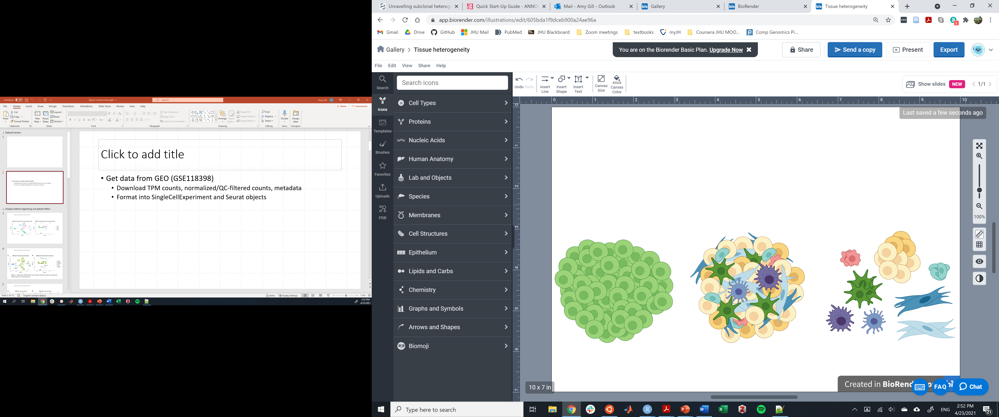
scRNA-seq to analyze tissue heterogeneity
Introduction
Tissues and tumors are ecosystems of functionally distinct cell types in various states, and these differences are obscured in bulk analysis methods
Single-cell RNA sequencing (scRNA-seq) allows transcriptome-scale investigation of tissue heterogeneity on a cellular level
Numerous downstream applications require individual cells in a dataset to first be classified into cell types in order to analyze clusters of similar cells – how?
Data and Methods
Results
Discussion
Future Directions
Bulk view of tumor
Single cell view of tumor
Goal: cluster cells by type

Slide 4
Overview of cell typing methods
Introduction
Devise decision rules based on expression of a small number of known marker genes
Pro: Uses biological knowledge for decision making
Cons: Markers may not be consistently expressed in all cells of a type or specific to one type; requires prior knowledge; can leave ambiguous cells unclassified
Use supervised machine learning methods to classify unknown cells based on training data on cells of known types
Pro: When possible, compares unknown cells to gold standard cell identities
Cons: Requires reliable scRNA-seq training data with known representative cell types, which may not exist; training data cell types have to be originally determined somehow
Use unsupervised learning methods to identify clusters of cells with similar characteristics
Pro: No prior knowledge or gold standard reference data required
Cons: Does not leverage existing biological knowledge; biological meaning of clusters unclear without further analysis (cluster-specific marker genes, etc.); “true” number of clusters unknown
Data and Methods
Results
Discussion
Future Directions

Slide 5
Goals of this study
Introduction
Find cell clusters in triple negative breast cancer (TNBC) scRNA-seq data using marker-based cell typing and various unsupervised clustering algorithms
Quantitatively compare composition of clusters/types produced by different approaches
To what degree do clusters produced by different algorithms produce the same groups of cells?
To what degree do clusters from by different algorithms have the same differentially expressed genes?
Implications of expected results
Some clustering methods may have better performance or produce more interpretable results
Ensemble approach could combine complementary clustering methods to give more robust cell typing
Data and Methods
HYPOTHESIS
Different clustering methods will capture similar biological information and produce similar clusters, but some methods will produce more similar results than others.
Results
Discussion
Future Directions

Slide 6
Data and Methods
Introduction
Data and Methods
Results
Discussion
Future Directions

Slide 7
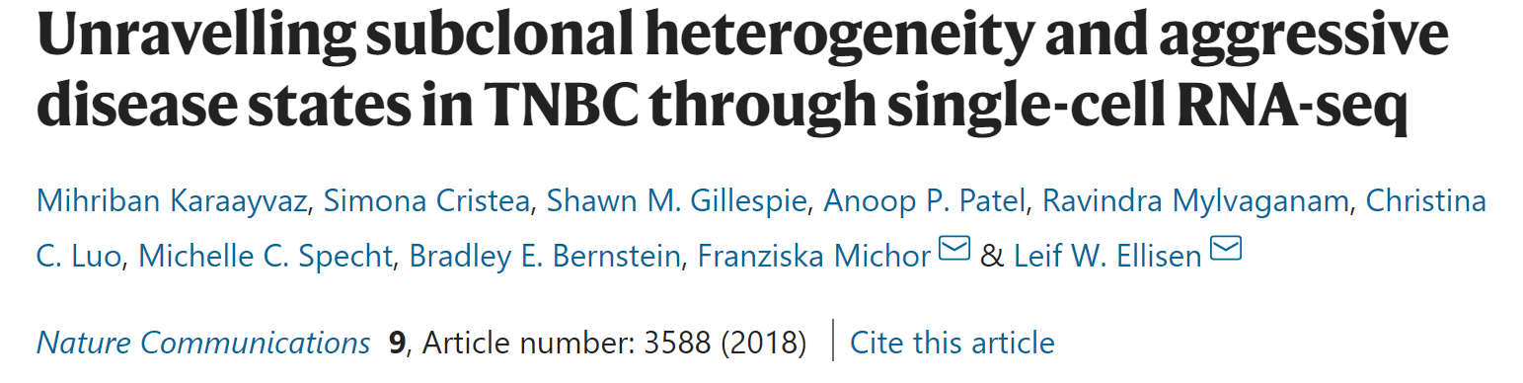
Data: TNBC scRNA-seq from Karaayvaz et al., 2018
Introduction
Data and Methods
Results
Downloaded TPM counts as well as QC-filtered, normalized data from GEO (GSE118398)
1189 QC-filtered cells from 6 TNBC patients
In the paper, cells were assigned to 6 cell types using a literature-based panel of marker genes (epithelial, stromal, endothelial, T cell, B cell, macrophage)
Markers and decision rules parsed from supplemental material
Discussion
Future Directions
Karaayvaz et al., 2018

Slide 8
Workflow
Introduction
Import data in R as SingleCellExperiment and Seurat objects
Remove patient-specific effects by linear regression
Find top 2000 variable features and find principal components (PCs)
Perform tSNE and UMAP projection of cells
Replicate marker-based cell typing using literature-based markers and decision rules
Visualize cell types with tSNE and UMAP
Find genes differentially expressed between cell types
Perform clustering with the Louvain algorithm using the top 50 PCs (Seurat)
Visualize clusters with tSNE and UMAP
Find cells differentially expressed between clusters
Use multimodal intersection analysis (MIA, Moncada et al., 2020) to quantify the degree of overlap between clusters/types produced by different algorithms
Data and Methods
Results
Discussion
Future Directions

Slide 9
Method details: literature-based cell typing
Introduction
Evaluate each cell for expression of 49 marker genes validated in breast tissue
“Expression” = normalized gene expression > 1
Classify cell as a certain type if it meets at least 1 or more of these
If no type, label “unknown”; if multiple, label “undecided” (except: epithelial/stromal = epithelial)
Data and Methods
Breast epithelial
Stromal
Endothelial
Immune types (T, B, macrophage)
EPCAM, KRT8, KRT18, KRT19, EGFR, CDH1, KRT14, ITGA6, KRT5, TP63, KRT17, MME, FOXA1, GATA3, MUC1, CD24, KIT, GABRP
FAP, COL1A1, COL3A1, COL5A1, ACTA2, TAGLN, LUM, FBLN1, COL6A3, COL1A2, COL6A1, COL6A2
PECAM1, VWF, CDH5, SELE
T cell: CD2, CD3D, CD3E, CD8A, CD8B
B cell: MS4A1, CD79A, CD79B, BLNK
Macrophage: CD14, CD68, CD163, CSF1R Pan-immune: PTPRC
Results
Markers
Discussion
2+ breast epithelial markers
1 well-defined breast epithelial marker expressed above median level for that marker for that patient
2+ stromal markers and no other markers
3+ stromal markers and 0-1 endothelial marker
2+ endothelial markers and no other markers
3+ endothelial markers and 0-1 stromal marker
2+ type-specific immune markers (T, B, macrophage) and no other immune markers
Pan-immune marker PTPRC, 1 type-specific immune marker, no other immune markers
3+ type-specific immune markers and 0-1 other immune markers
Decision rules
Future Directions

Slide 10
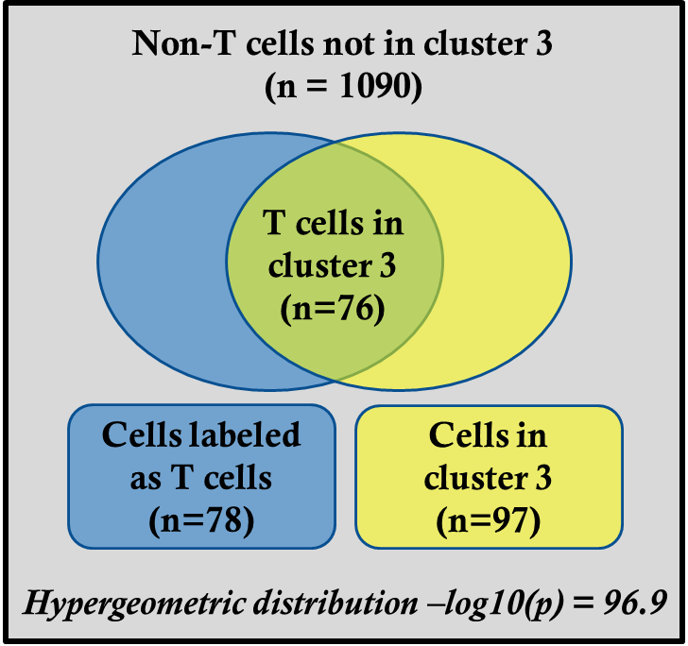
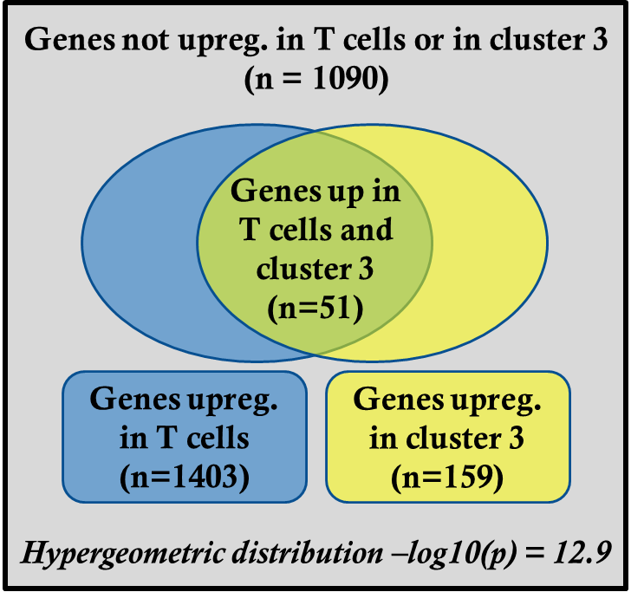
Method details: multimodal intersection analysis (MIA)
Introduction
Data and Methods
Results
MIA = fancy name for hypergeometric test for enrichment (Moncada et al., 2020)
Do groups consist of overlapping cells more frequently than expected by chance?
Do sets of differentially expressed genes overlap more than expected by chance?
Calculate p-value for all cell-type/cluster pairs, display as heat map
Discussion
Future Directions
Figures adapted from Moncada et al., 2020

Slide 11
Results
Introduction
Data and Methods
Results
Discussion
Future Directions

Slide 12
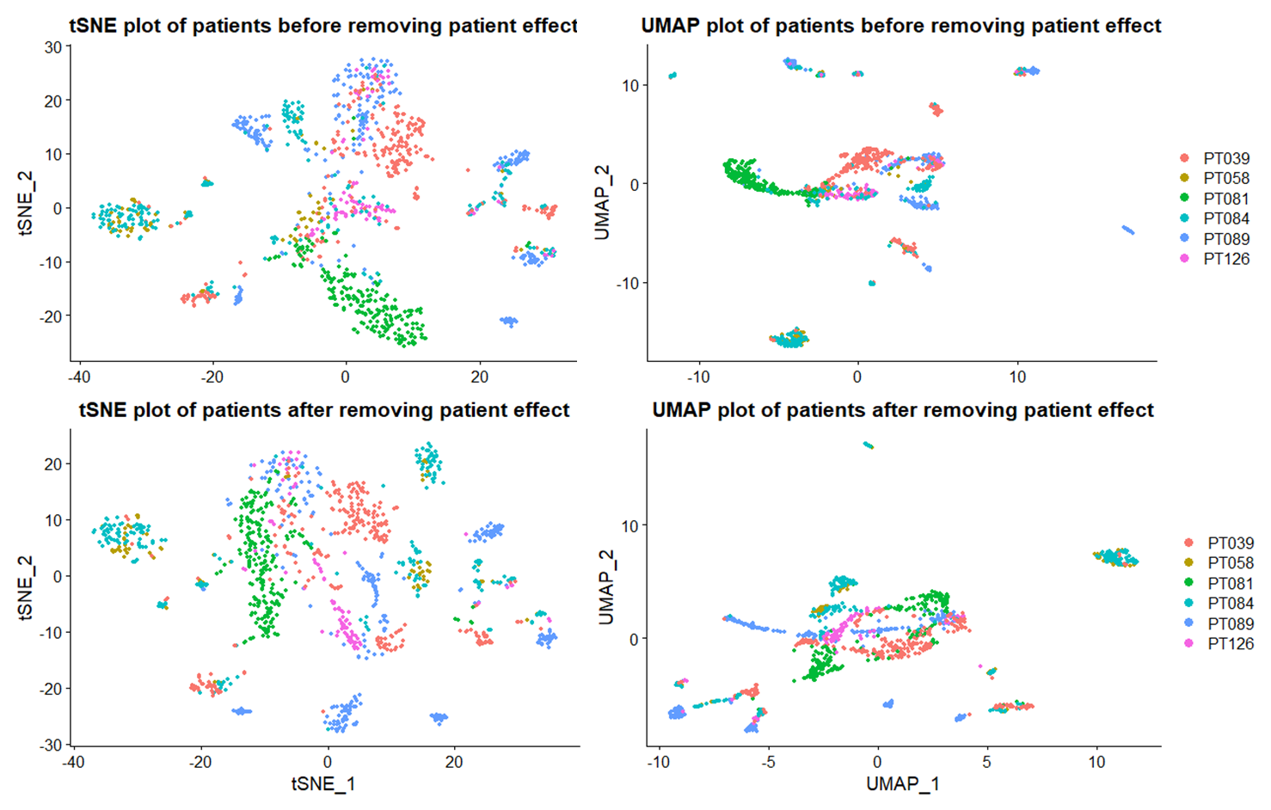
tSNE/UMAP before and after removing patient effect
Introduction
Data and Methods
Results
Discussion
Future Directions

Slide 13
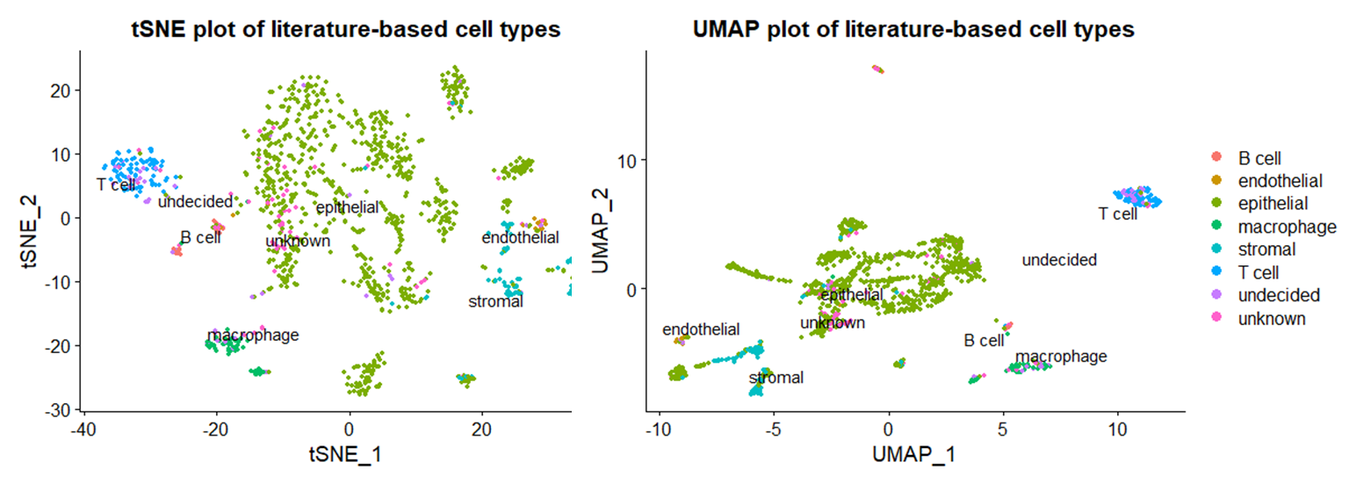
Literature-based cell typing: tSNE/UMAP
Introduction
Data and Methods
Results
3 major divisions: epithelial, stromal/endothelial, immune
Most cells are epithelial, with multiple apparent subtypes
Other cell types tend to form fairly consistent and compact clusters
Some epithelial cells cluster near stroma – either reflects EMT or decision rule failure
Most undecided cells are immune, most unknown cells are epithelial
Discussion
Future Directions

Slide 14
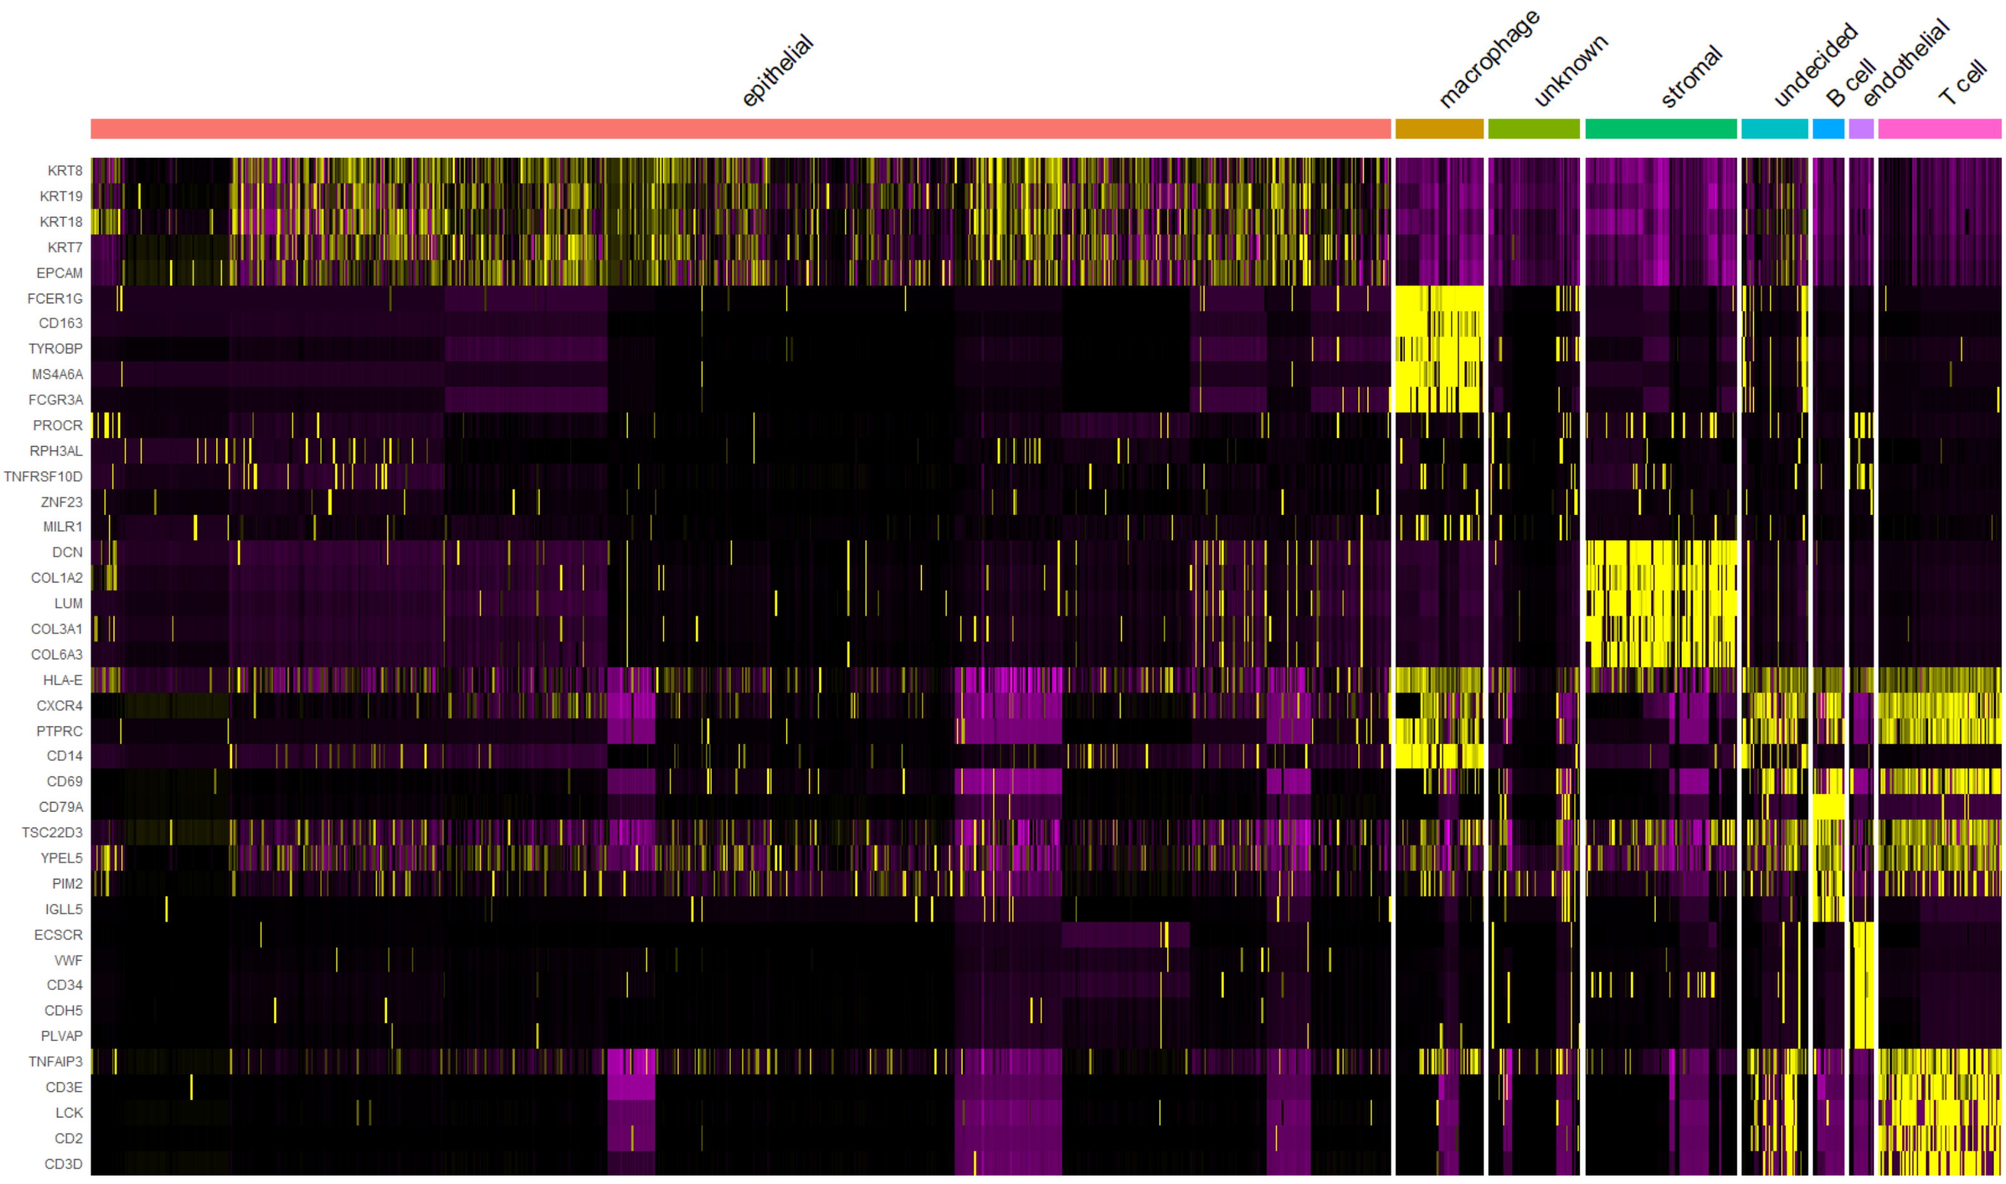
Literature-based cell typing: differentially expressed genes
Introduction
Includes several markers used to assign cell types
Also includes some known markers not used by decision rules (CD34, LCK, …)
Consistent gene expression profiles suggest marker-based cell typing reflects true biological differences
But several “undecided” cells clearly match certain cell-type-specific expression profiles
Data and Methods
Results
Discussion
Future Directions

Slide 15
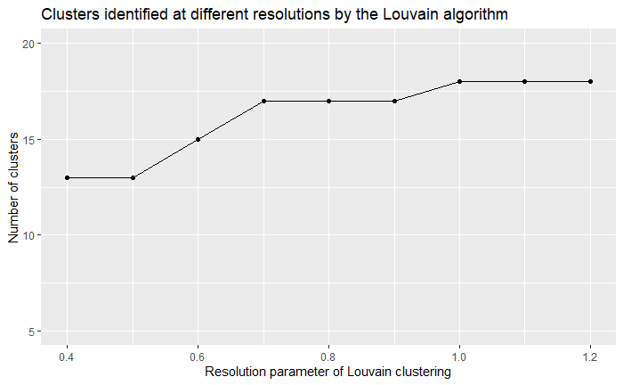
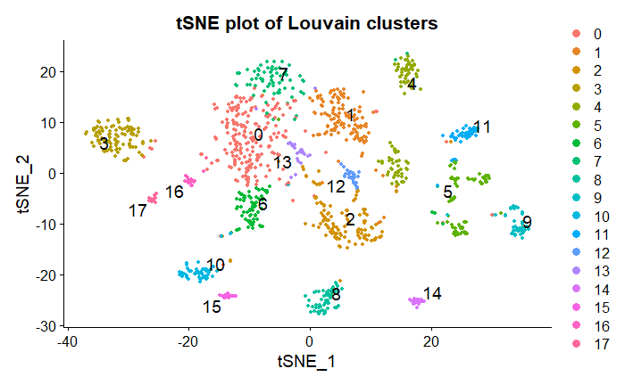
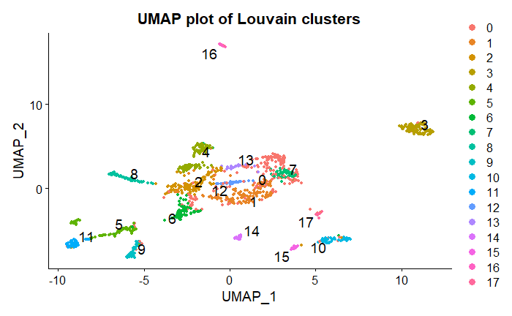
Clustering with the Louvain algorithm
Introduction
Tested a variety of resolutions (0.4-1.2): 18 clusters at resolution 1.0
Clusters reflect consistent visual groupings in projected data
Data and Methods
Results
Discussion
Future Directions

Slide 16
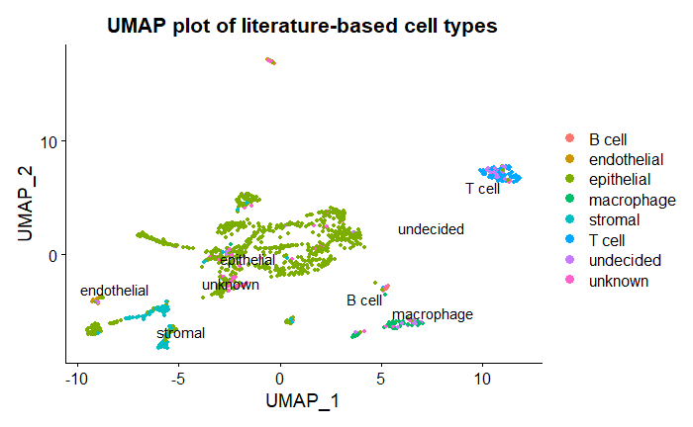
Visual comparison: cell types and Louvain clusters
Introduction
Data and Methods
Results
Cell types well-represented by 1-2 clusters: T cells (3), B cells (16, 17), macrophages (10, 15), stroma (5, 9)
Cell type without an independent cluster: endothelial (5 with stroma, but visually distinct)
Numerous clusters with epithelial identity
Undecided/unknown cells are spread throughout existing clusters, not independent
Discussion
Future Directions

Slide 17
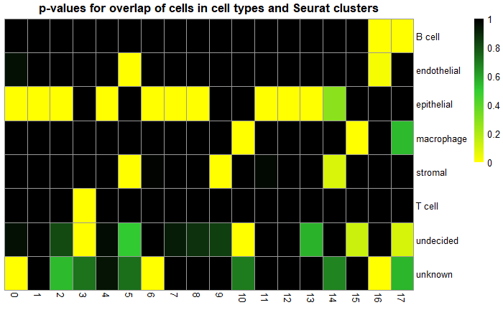
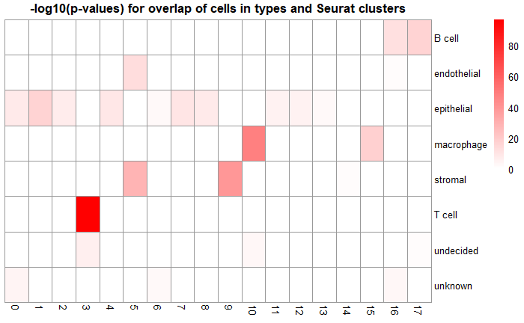
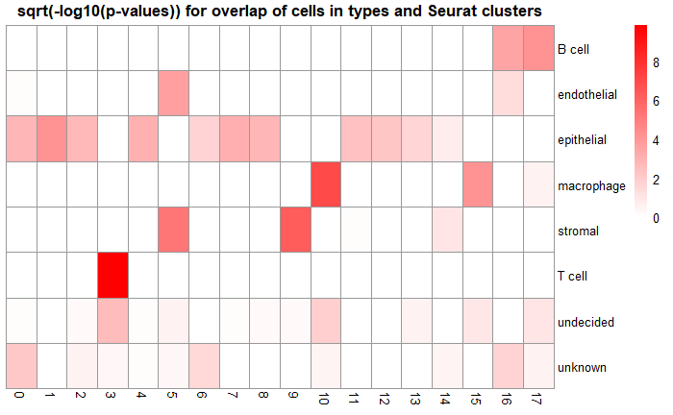
MIA for cells: cell type and Seurat cluster
Introduction
Data and Methods
Results
NOTE: only looking at enrichment of cells
Certain cell types are statistically enriched in certain clusters, matching visual inspection
Overlap is most significant for T cells, macrophages, stroma, B cells
Less enrichment for epithelial clusters – likely reflects multi-cluster split of epithelial cells
Discussion
Future Directions

Slide 18
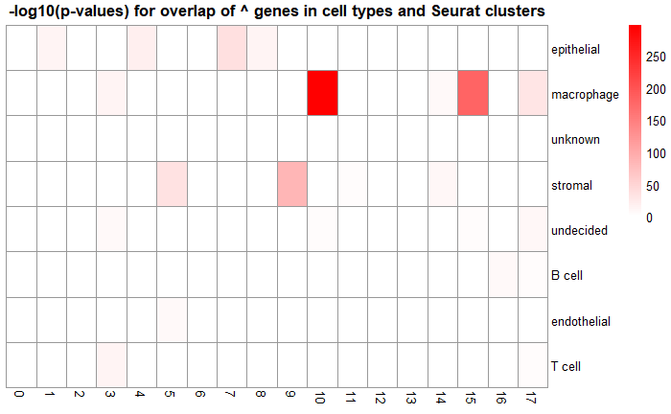
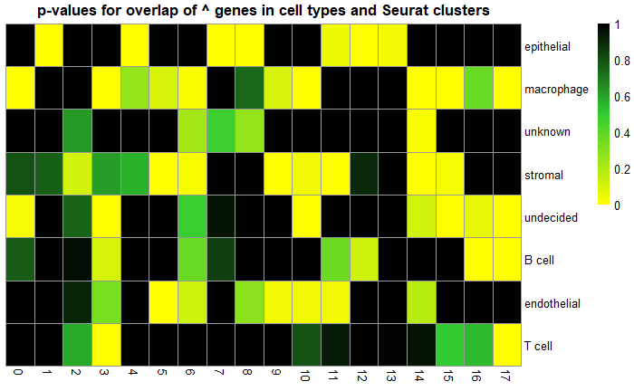
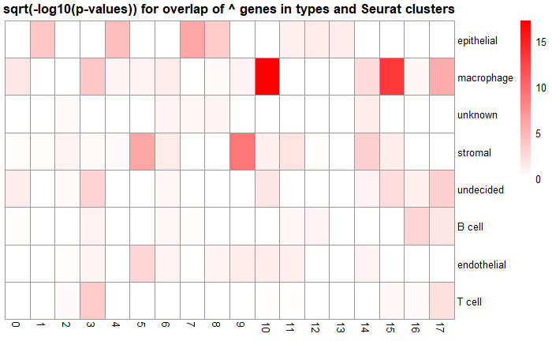
MIA for upregulated genes: cell type and Seurat cluster
Introduction
Data and Methods
Results
NOTE: row order differs from last slide (will fix in longer term)
NOTE: only looking at upregulated genes and only looking at enrichment
Similar gene sets are enriched in some cell types and some clusters, reflecting a shared biological identity
Most coherent gene sets: macrophage and 10, 15
Discussion
Future Directions

Slide 19
Discussion
Introduction
Data and Methods
Results
Discussion
Future Directions

Slide 20
Cell typing with literature-based markers
Introduction
Pros
Cons
Leverages existing knowledge of cell biology
Can separate cells into biologically meaningful cell types with similar gene expression patterns (if markers are well-selected)
Groups have clear biological interpretability
Can define arbitrarily complex rules to separate out cell subtypes
Can overlook cells with highly similar expression profiles that happen not to express the chosen markers (heterogeneity, technical dropout)
Unclassified or multiply-classified cells are not easily interpreted
Can obscure differences between subtypes of larger cell groups
Subjectivity and bias in defining robust markers and rational decision rules
Markers may be inconsistent in different biological conditions
Data and Methods
Results
Discussion
Future Directions

Slide 21
Cell typing with Louvain clustering
Introduction
Pros
Cons
Does not depend on existing biological knowledge
Can separate cells into biologically meaningful cell types with similar gene expression patterns
No unclassified cells
Can identify cell subtypes within larger clusters
More independent of researcher bias
Does not leverage existing knowledge
Not immediately interpretable, requires biological knowledge to annotate the clusters (subject to selective inference)
No clear rules for deciding how many clusters to generate from the data – final clusters may not be parsimonious
Data and Methods
Results
Discussion
Future Directions

Slide 22
Can we find a better way?
Introduction
Probably, especially if annotated reference datasets exist to train classifiers
Numerous supervised cell typing methods (scmap, scVI, SingleCellNet, …) train various algorithms to assign cells to types, but performance varies by dataset
Extensive benchmarking has been performed (e.g. Abdelaal et al., 2019)
To benchmark methods, ground truth cell type must be known
Approach is unclear when annotated reference datasets do not exist, which is currently true in several tissues and contexts
Literature-based methods and unsupervised clustering have complementary strengths and weaknesses – can they be combined?
Probably would increase performance
But difficult or impossible to assess performance with accuracy/precision/recall when true annotations are unknown
Data and Methods
Results
Discussion
Future Directions

Slide 23
Future Directions
Introduction
Data and Methods
Results
Discussion
Future Directions

Slide 24
Short term future directions: extend to additional unsupervised clustering methods
Introduction
Options
Graph-based methods: Leiden, infomap
Distance-based methods: Hierarchical clustering with different linkages
Centroid-based methods: k-means
Density-based methods: DBSCAN, mean shift
Workflow
Apply clustering, label cells, find differentially expressed genes
Use MIA to compare to literature-based cell types and to previous clustering results
Data and Methods
Results
Discussion
Future Directions

Slide 25
Longer term future directions
Introduction
Find supervised cell typing methods that can be performed with existing databases
Caveat: currently human breast tissue is not in the Human Cell Atlas or other databases
Mouse breast tissue has been analyzed
Some methods (e.g. SingleCellNet) can perform cross-species classification
Experiment with ensemble methods that combine different unsupervised (and possibly supervised) clustering approaches
Would need to switch/expand to a dataset with high confidence cell type annotations to assess performance
Decide on “best” cell type classifications and perform downstream single cell analysis
Infer cell-cell interactions important to these tumors
Use to build mechanistic models of tumor ecosystem signaling
Data and Methods
Results
Discussion
Future Directions

Slide 26
Acknowledgments
References
Abdelaal, T., Michielsen, L., Cats, D., Hoogduin, D., Mei, H., Reinders, M. J. T., & Mahfouz, A. (2019). A comparison of automatic cell identification methods for single-cell RNA sequencing data. Genome Biology, 20(1), 194. https://doi.org/10.1186/s13059-019-1795-z
*** Karaayvaz, M., Cristea, S., Gillespie, S. M., Patel, A. P., Mylvaganam, R., Luo, C. C., Specht, M. C., Bernstein, B. E., Michor, F., & Ellisen, L. W. (2018). Unravelling subclonal heterogeneity and aggressive disease states in TNBC through single-cell RNA-seq. Nature Communications, 9(1), 3588. https://doi.org/10.1038/s41467-018-06052-0
Moncada, R., Barkley, D., Wagner, F., Chiodin, M., Devlin, J. C., Baron, M., Hajdu, C. H., Simeone, D. M., & Yanai, I. (2020). Integrating microarray-based spatial transcriptomics and single-cell RNA-seq reveals tissue architecture in pancreatic ductal adenocarcinomas. Nature Biotechnology, 38(3), 333–342. https://doi.org/10.1038/s41587-019-0392-8
Stuart, T., Butler, A., Hoffman, P., Hafemeister, C., Papalexi, E., Mauck, W. M., Hao, Y., Stoeckius, M., Smibert, P., & Satija, R. (2019). Comprehensive Integration of Single-Cell Data. Cell, 177(7), 1888-1902.e21. https://doi.org/10.1016/j.cell.2019.05.031
Alexis Battle
Ashton Omdahl
Feilim Mac Gabhann
And you!
Thank you!
Questions?

